Slide 1
Introduction to Embedded Systems
Edward A. Lee & Prabal Dutta
UC Berkeley
EECS 149/249A
Fall 2017
Module 1:
Motivation: Cyber Physical Systems
Notes:
<number>

Slide 2
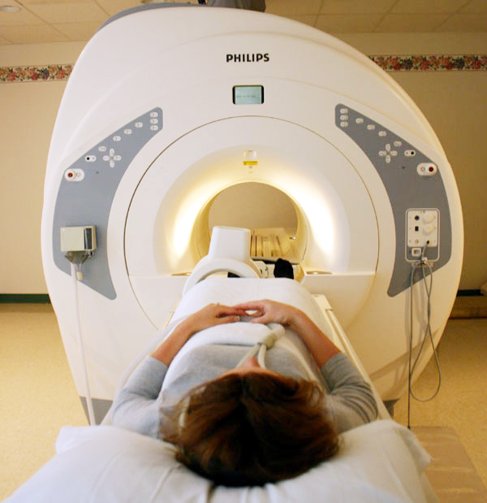
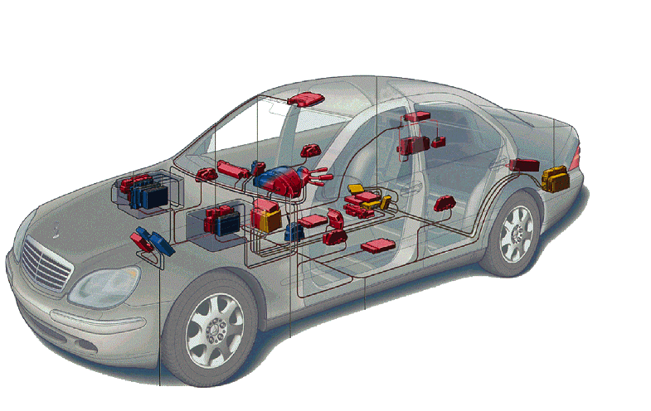
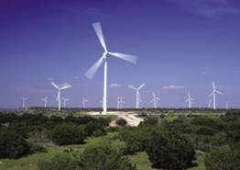
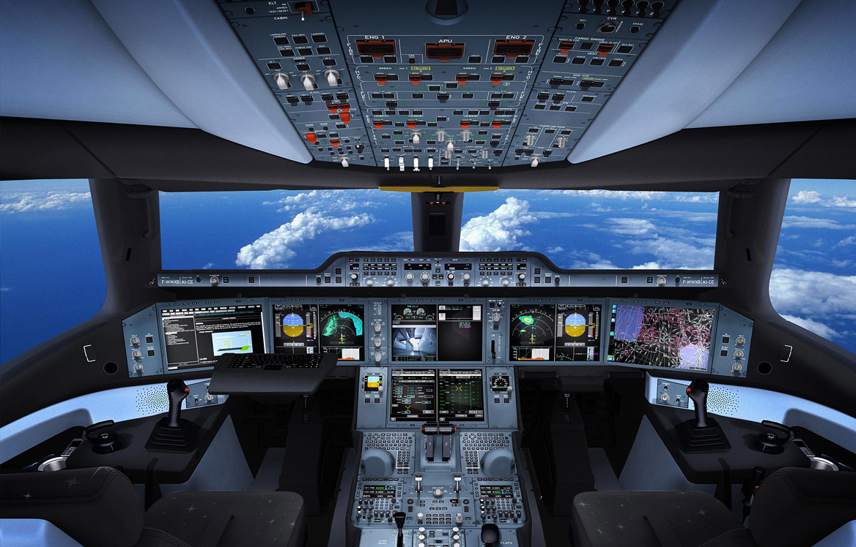
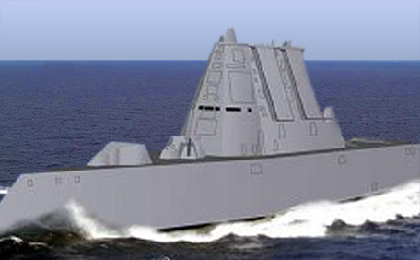
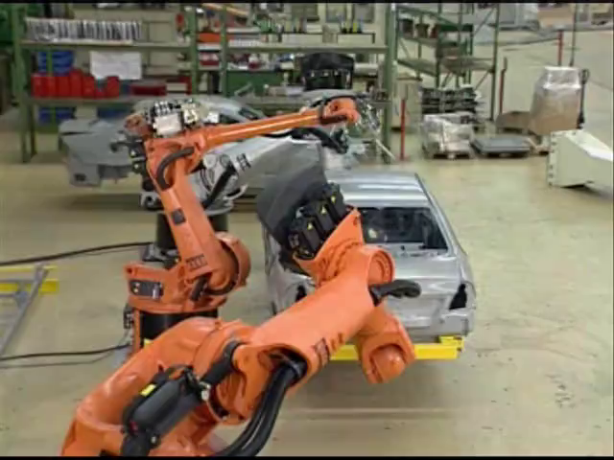
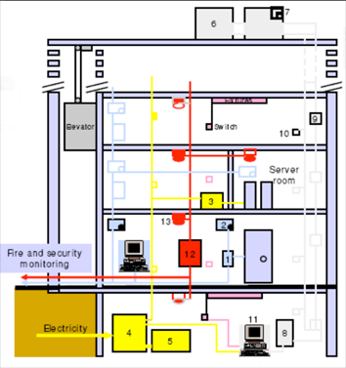
Focus on Cyber-Physical Systems Full of Contradictory Requirements
It’s not just information technology anymore:
Cyber + Physical
Computation + Dynamics
Security + Safety
Contradictions:
Adaptability vs. Repeatability
High connectivity vs. Security and Privacy
High performance vs. Low Energy
Asynchrony vs. Coordination/Cooperation
Scalability vs. Reliability and Predictability
Laws and Regulations vs. Technical Possibilities
Economies of scale (cloud) vs. Locality (fog)
Open vs. Proprietary
Algorithms vs. Dynamics
Innovation:
Cyber-physical systems require new engineering
methods and models to address these contradictions.
Biomedical
Energy
Automotive
Avionics
Military
Buildings
Manufacturing
Lee, Berkeley
Notes:
<number>

Slide 3
E Pluribus Unum: Out of Many, One
Smarter Planet
Internet of Everything
Machine to Machine (M2M)
Internet of Things (IoT)
The Fog
Industry 4.0
TSensors (Trillion Sensors)
The Industrial Internet
Cyber-Physical Systems
Lee, Berkeley

Slide 4
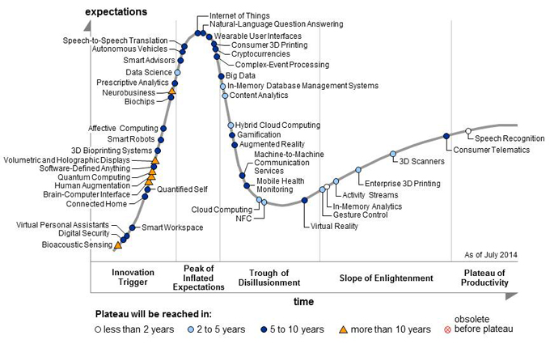
The Hype Around The Internet of Things
Using Internet technology to connect physical devices (“things”).
Internet of Things
Peak of Inflated Expectations
http://www.gartner.com/technology/research/hype-cycles/
Lee, Berkeley

Slide 5
The Hype Around The Internet of Things
Using Internet technology to connect physical devices (“things”).
Internet of Things
Trough of Disillusionment
http://www.gartner.com/technology/research/hype-cycles/
Lee, Berkeley

Slide 6
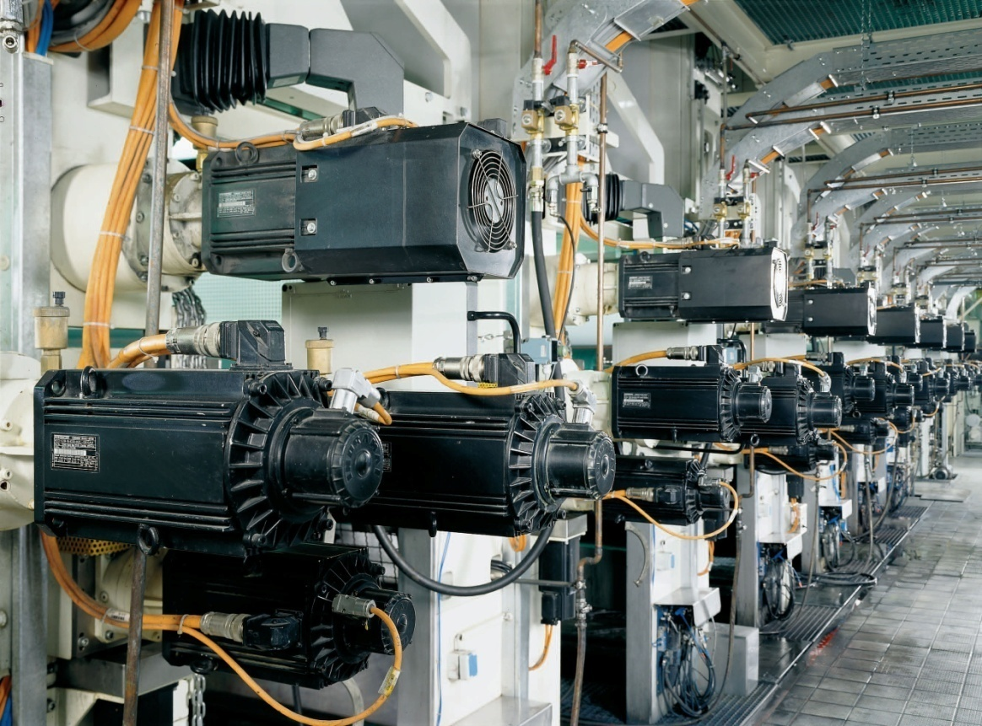
IoT is the use of Internet technology for Cyber-Physical Systems
Industrial automation example from 2008: Bosch-Rexroth printing press.
The term “IoT” includes the technical solution “Internet technology” in the problem statement “connect things”.
The term CPS does not.
This Bosch Rexroth printing press is a cyber-physical factory using Ethernet and TCP/IP with high-precision clock synchronization (IEEE 1588) on an isolated LAN.
Lee, Berkeley
<number>

Slide 7
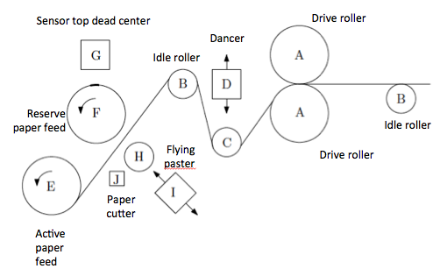
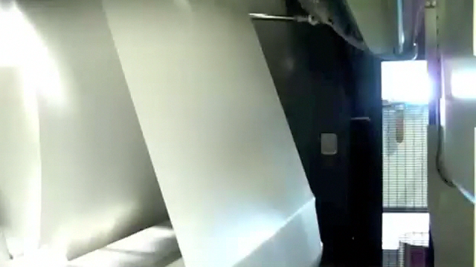
Example – Flying Paster
Source: http://offsetpressman.blogspot.com/2011/03/how-flying-paster-works.html
Notes:
paper feed mechanism followed by several offset-printing
rollers in turn followed by units that cut, fold, and bundle the output
<number>

Slide 8
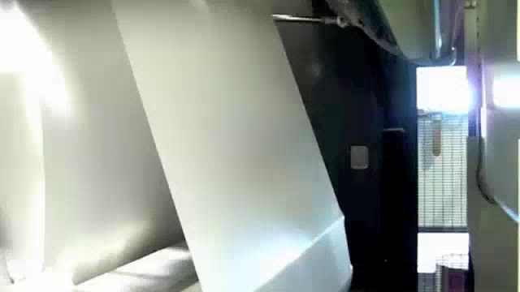
Source: http://offsetpressman.blogspot.com/2011/03/how-flying-paster-works.html
Flying Paster

Slide 9
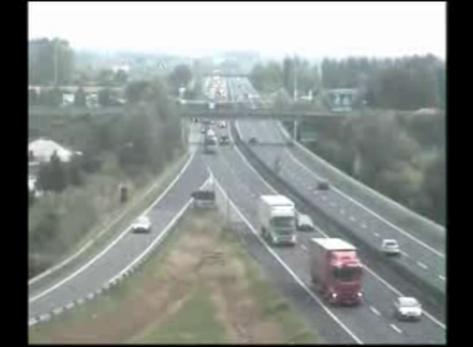
CPS Challenge Problem: Prevent This
Notes:
Dr. Volkmar Denner gave keynote yesterday. Emphasis on user experience. Key parts user experience are safety, confidence, and trust.
Edward A. Lee
02/18/2019
<number>

Slide 10
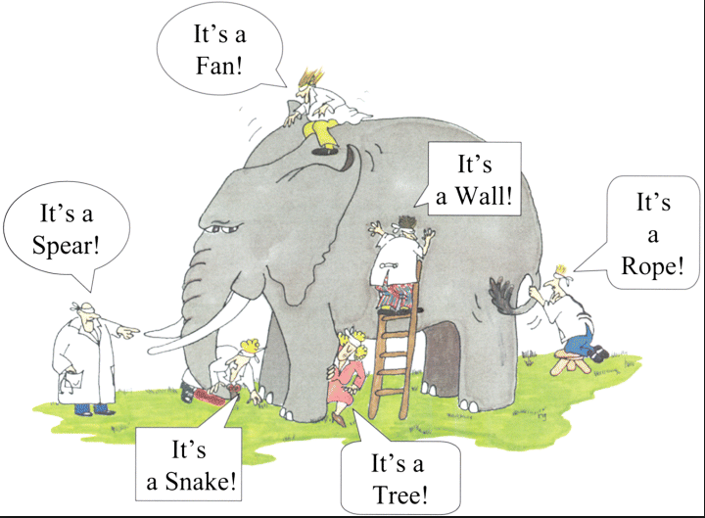
The challenges of working in a multidisciplinary area
x

Slide 11
The challenges of working in a multidisciplinary area
Small Computer
x
Connected Industrial System
Network
Big Complex System
Advanced Manufacturing
Robot

Slide 12
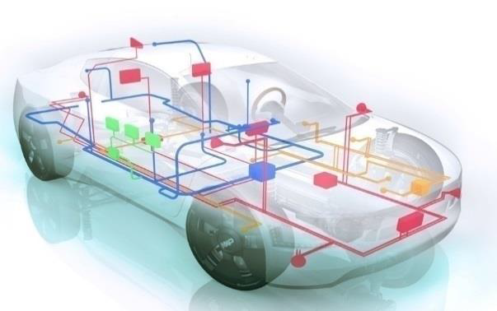
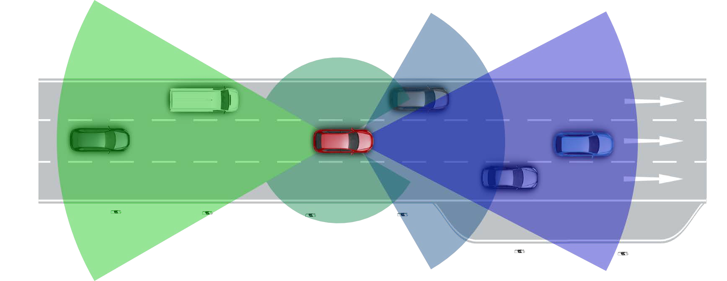
Automotive CPS and Societal Challenges
Safer Transportation
Reduced Emissions
Smart Transportation
Energy Efficiency
Climate Change
Human-Robot Collaboration
Notes:
<number>

Slide 13
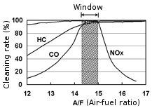
Example: Air-Fuel ratio control to reduce emissions
Catalytic converters reduce CH₄, CO₂, and NO_{x} emissions
Conversion efficiency optimal at stoichiometric value
See:
Jin. Kapinski. Deshmukh,
Ueda, Butts,
“Powertrain Control Verification Benchmark,”
HSCC 2014
[Slide due to J. Deshmukh, Toyota]

Slide 14
Air-Fuel ratio control: Gasoline Engine setting
Exhaust manifold
Fuel injectors
Measured A/F
Software
Measured Air Flow
AIR
Intake manifold
[Slide due to J. Deshmukh, Toyota]

Slide 15
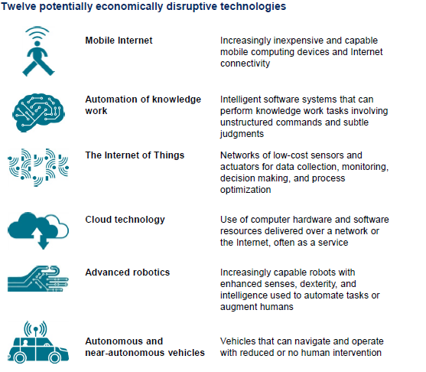
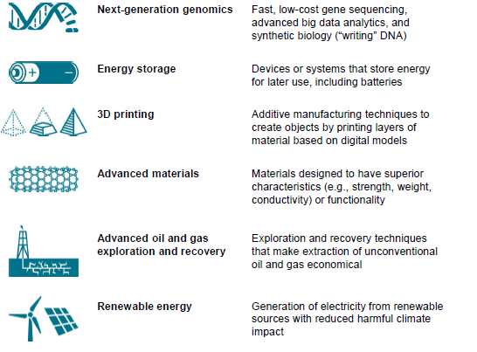
Report: McKinsey Global Institute Disruptive technologies: Advances that will transform life, business, and the global economy May 2013
… with major CPS components
Notes:
<number>

Slide 16
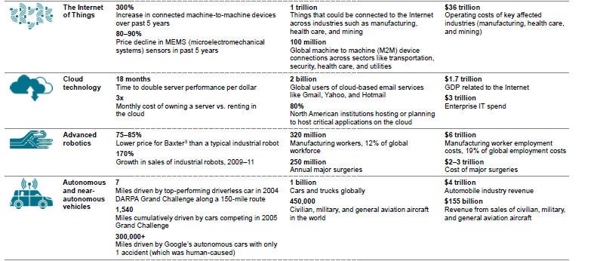
Economic Potential

Slide 17
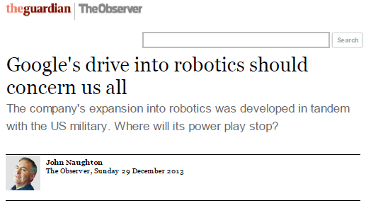
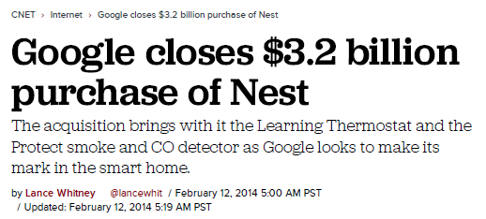
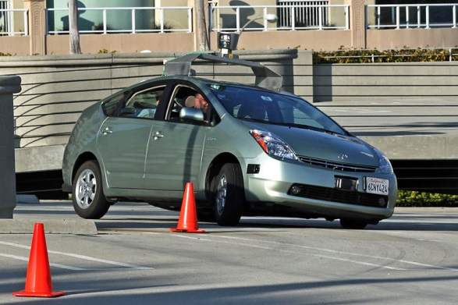
Google Strategy
Google's robotic cars have about $150,000 in equipment including a $70,000 LIDAR (laser radar) system. The range finder mounted on the top is a Velodyne 64-beam laser. This laser allows the vehicle to generate a detailed 3D map of its environment.
The car then takes these generated maps and combines them with high-resolution maps of the world, producing different types of data models that allow it to drive itself.
Notes:
<number>

Slide 18
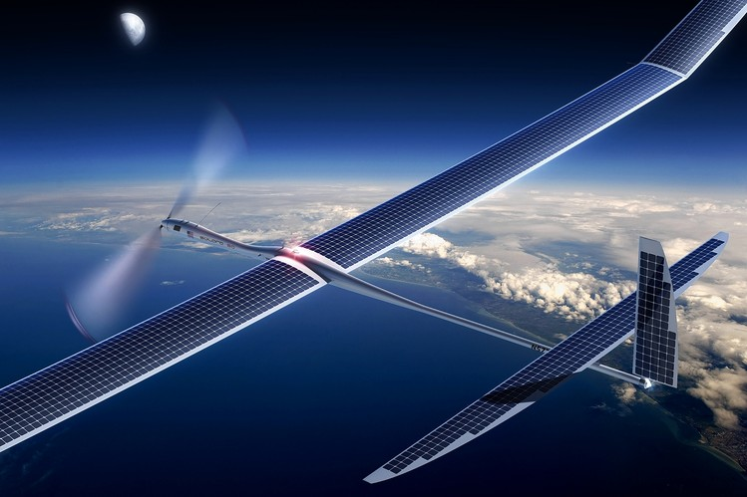
Google and Facebook
Wall Street Journal:
By Alistair Barr and Reed Albergotti
April 14, 2014
Google Inc. on Monday acquired a maker of solar-powered drones—a startup that Facebook Inc. had also considered acquiring—as the technology giants battle to extend their influence and find new users in the far corners of the earth.
Artist's rendering of Titan's Solara 50, which in theory at least, can stay aloft for years.

Slide 19
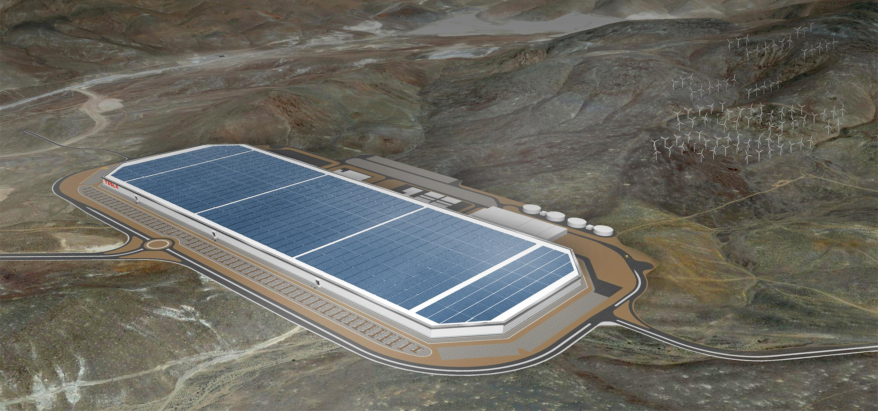
Tesla Gigafactory
Artists conception of battery factory under construction in Nevada.
From: https://www.tesla.com/gigafactory

Slide 20
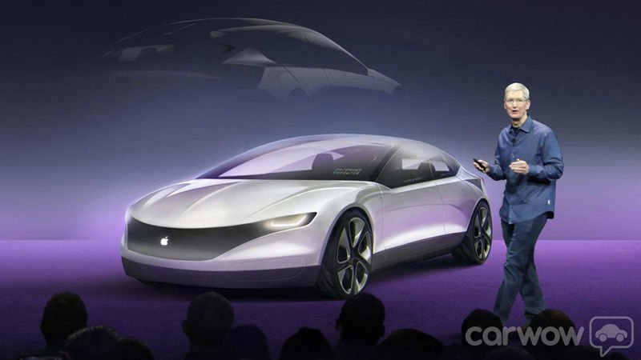
Apple iCar?
Macworld, Aug. 10, 2016:
Reports suggest that Apple is developing an electric iCar to rival Tesla. With reports that Apple is negotiating with BMW, and poaching Samsung employees (especially battery specialists) and reassigning large numbers of staff for its Project Titan, is Apple manufacturing an iCar, and when will the iCar be launched?

Slide 21

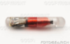

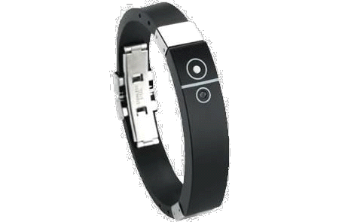
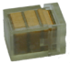

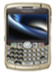
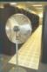
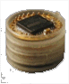

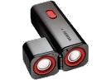

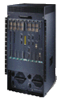
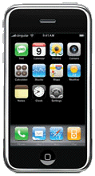
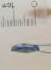

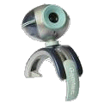

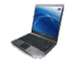




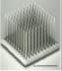
The Emerging IT Scene
Infrastructural
core
The Cloud!
Sensory swarm
Mobile
access
Courtesy: J. Rabaey
<number>
Notes:
<number>

Slide 22
What this course is about
A principled, scientific approach to designing and implementing embedded systems
Not just hacking!!
Hacking can be fun, but it can also be very painful when things go wrong…
Focus on model-based system design, and on embedded software

Slide 23
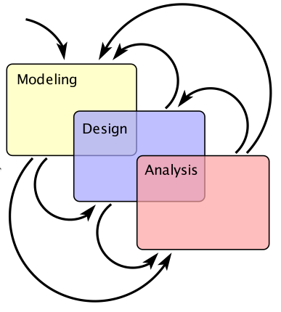
Modeling, Design, Analysis
Modeling is the process of gaining a deeper understanding of a system through imitation. Models express what a system does
or should do.
Design is the structured creation of artifacts. It specifies how a system does what it does.
Analysis is the process of gaining a deeper understanding of a system through dissection. It specifies why a system does what it does (or fails to do what a model says it should do).

Slide 24
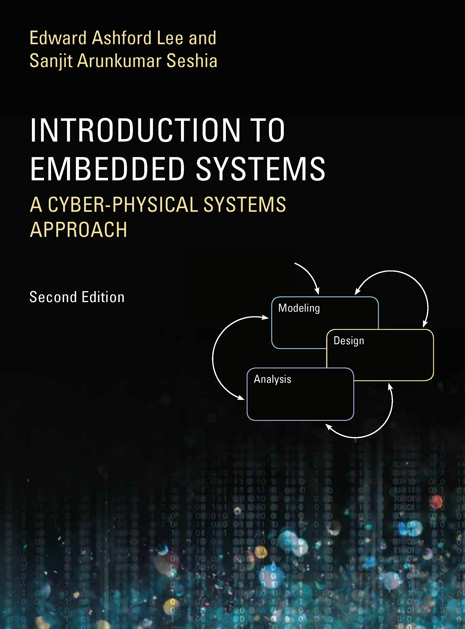
Your textbook, written for this course, strives to identify and introduce the durable intellectual ideas of embedded systems as a technology and as a subject of study. The emphasis is on modeling, design, and analysis of cyber-physical systems, which integrate computing, networking, and physical processes.
http://LeeSeshia.org

Slide 25
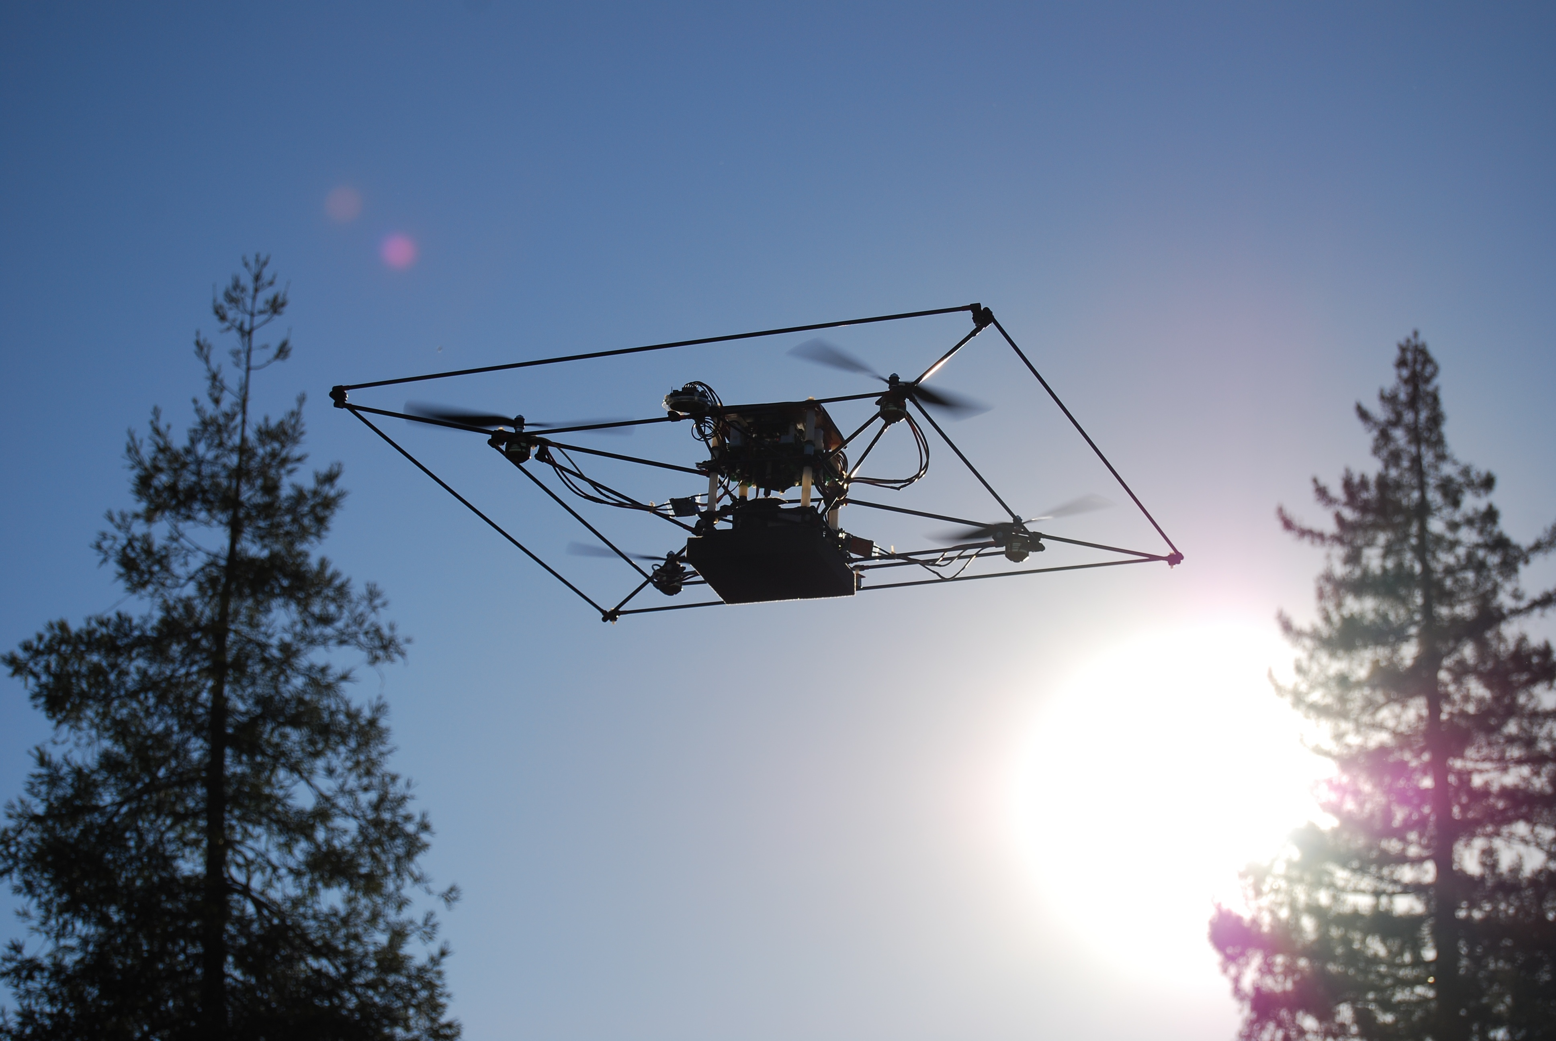
Motivating Example of a Cyber-Physical System (see Chapter 1 in book)
Modeling:
Flight dynamics (ch2)
Modes of operation (ch3)
Transitions between modes (ch4)
Composition of behaviors (ch5)
Multi-vehicle interaction (ch6)
Design:
Sensors and Actuators (ch7)
Processors (ch8)
Memory system (ch9)
Sensor interfacing (ch10)
Concurrent software (ch11)
Real-time scheduling (ch12)
Analysis
Specifying safe behavior (ch13)
Achieving safe behavior (ch14)
Verifying safe behavior (ch15)
Guaranteeing timeliness (ch16)
Security and privacy (ch17)
STARMAC quadrotor aircraft (Tomlin, et al.)
Introductory Video:
http://www.youtube.com/watch?v=rJ9r2orcaYo
Back-Flip Manuever:
http://www.youtube.com/watch?v=iD3QgGpzzIM

Slide 26
STARMAC Design Block Diagram
LIDAR
URG-04LX
10 Hz ranges
RS232
115 kbps
PC/104
Pentium M 1GB RAM, 1.8GHz
Est. & control
WiFi
802.11g+
≤ 54 Mbps
USB 2
480 Mbps
Stereo Cam
Videre STOC
30 fps 320x240
Firewire
480 Mbps
RS232
GPS
Superstar II
10 Hz
UART
19.2 kbps
Stargate 1.0
Intel PXA255 64MB RAM, 400MHz
Supervisor, GPS
CF
100 Mbps
WiFi
802.11b
≤ 5 Mbps
UART 115 Kbps
IMU
3DMG-X1
76 or 100 Hz
UART
UART
115 kbps
Robostix
Atmega128
Low level control
Ranger
SRF08
13 Hz Altitude
I²C
400 kbps
PPM 100 Hz
Analog
Ranger
Mini-AE
10-50 Hz Altitude
Beacon
Tracker/DTS
1 Hz
ESC & Motors
Phoenix-25, Axi 2208/26
Timing/ Analog

Slide 27
A Theme in This Course: Think Critically
Any course that purports to teach you how to design embedded systems is misleading you.
The technology will change!
Our goal is to teach you how things are done today, and why that is not good enough. So you will not be surprised by the changes that are coming.

